Slide 1
Hotel RATINGS AND Reviews
MSA 8040 DBMS
Sandeep Gunda
Lei Feng
Mohit Savani
Liying Wei
Young Jae Woo

Slide 2
AGENDA
Problem Identification
Data Explanation
ERD, Normalization, Table Structure
Structured Data
Queries
Unstructured Data
Data Input, Sentiment Analysis, Queries
Conclusion

Slide 3
Problem Identification.
Today, hotels face fierce competition among each other and with alternative accommodation, such as Airbnb. Despite this competition, many hotels and online booking sites are still simply relying on numerical ratings that customers provide as an evaluation metric. However, numerical ratings do not encompass the sentiment or feeling of customers. To address this problem, we examined the importance of reviews that customers actually write, as we deemed these texts are far better in capturing customer experience.

Slide 4
Data Sources
TripAdvisor (http://times.cs.uiuc.edu/~wang296/Data/)
Kaggle
Expedia
We have 200 hotels in our data file and each data file contains more than 20 reviews par hotel
In Our project we take 200 hotels and more than 12 reviews par hotel so, we have near 2500 total number of reviews.

Slide 5
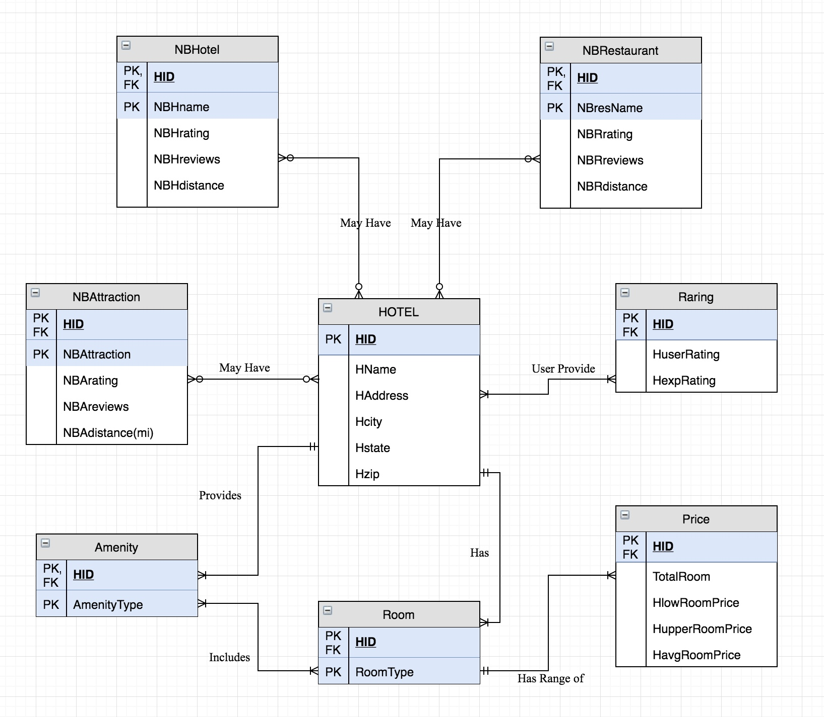
ER Diagram

Slide 6
Entities
Hotel: HID, Hname, Haddress, Hcity, Hstate, Hzip
Raring: HID, Huserrating, Hexprating
Price: HID, HtotalRoom, HlowRoomPrice, HupperRoomPrice, HavgRoomPrice
Room: HID, Room Type
Amenity: HID, Amenity Type
NBHotel: HID, NBHname, NBHrating, NBHreviews, NBHdistance
NBAttraction: HID, NBAttraction, NBArating, NBAreviews, NBAdistance
NBRestaurant: HID, NBresName, NBRrating, NBRreviews, NBRdistance

Slide 7
Relations
According to ER diagram we assume that the hotel may or may not be near by restaurants, other hotel and attraction
And between hotel and rating according to data the past user provides at least one rating and hotel has at least one rating provided by the user.
For amenity and hotel, hotel provides many services to room and other thing like(bar, tennis court, pool, ..etc) and amenity provided by only one hotel.
And hotel has many room and room has different price according to different occasions and festival.

Slide 8
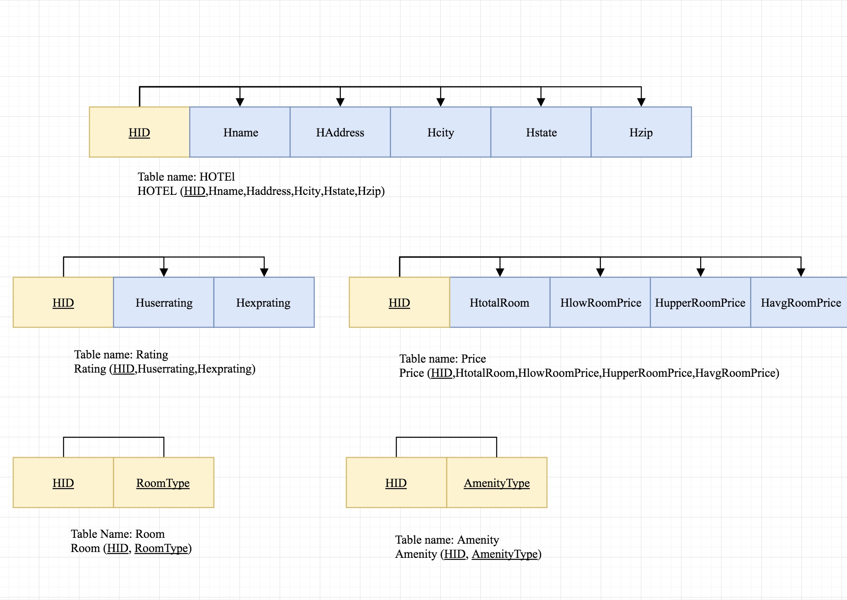
Normalization

Slide 9
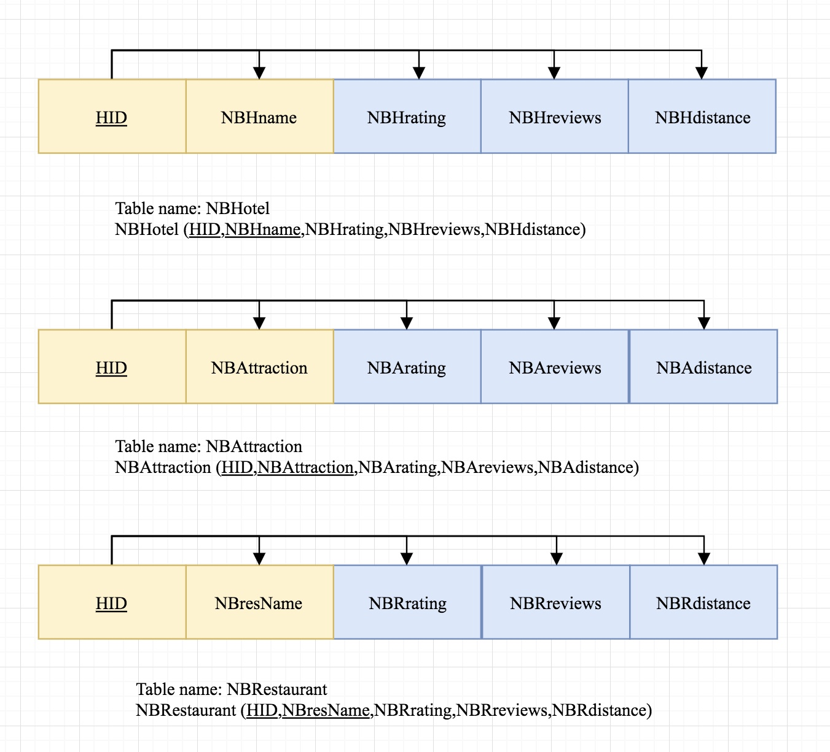

Slide 10
Structured DATA
Query 1:

Slide 11
Query 2:

Slide 12
Query 3:

Slide 13
Query 4:

Slide 14
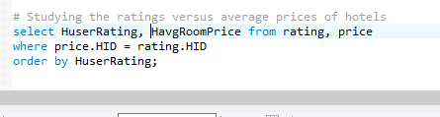
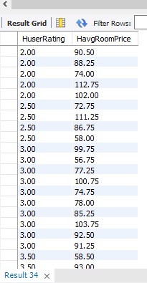
Query 5:

Slide 15
Unstructured DATA
Extremely difficult to quantify human feelings in a “out-of-5-star” format
In order to see if there is a disparity between numerical ratings and actual written customer reviews, it is very important to analyze the customers experience.
Giving an accurate numerical rating is harder than just mentioning what they liked and disliked in the reviews.

Slide 16
Sentiment Analysis
Utilized Semantria

Slide 17
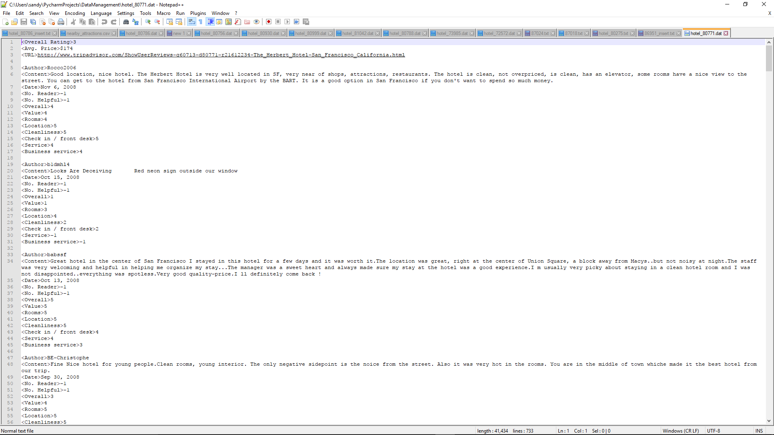

Slide 18
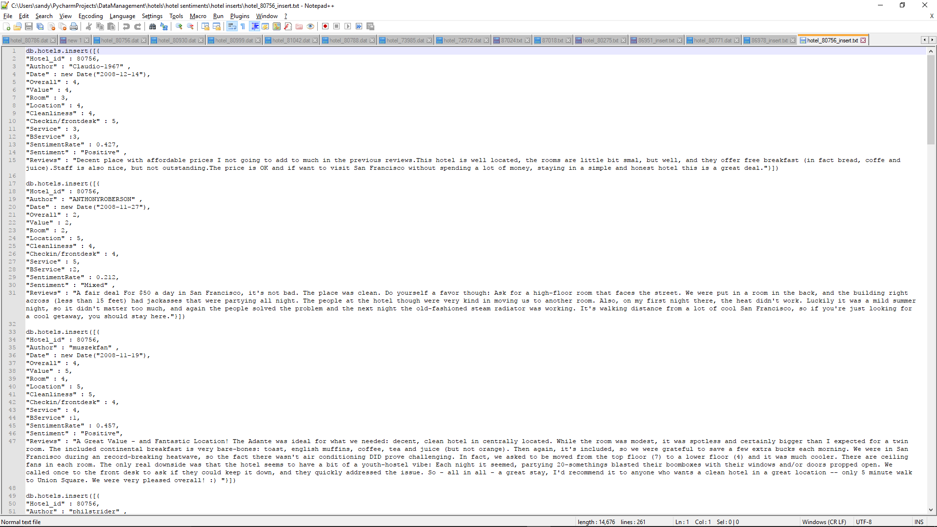

Slide 20
Queries
Query 1
#average sentiment
ratedb.hotels.aggregate( { $group : {_id : "Hotel_id", avgSentRate : {$avg : "$SentimentRate"} } } )

Slide 21
Query 2:
#average overall
ratingdb.hotels.aggregate( { $group : {_id : "Hotel_id", avgOverall : {$avg : "$Overall"} } } )

Slide 22
Query 3:
#suppress the outliers
(SentimentRate>1 and SentimentRate<-1)db.hotels.find( { $and: [ {SentimentRate : {$lt : 1.0}},
{SentimentRate: {$gt : -1.0}}] } , {Reviews : 0}).count()

Slide 23
Query 4:
#find "unmatching" overall rating and sentiment rate
#Sentiment is abnormally low compared to the overall customer
ratingdb.hotels.find( { Overall : { $gt: 3.5}, SentimentRate : { $lt : 0.2 }} )

Slide 24
Query 5:
#Sentiment is abnormally high compared to the overall customer ratingdb.hotels.find( { Overall : { $lt: 3.5}, SentimentRate : { $gt : 0.4 }} )

Slide 25
Conclusion
Even though most of the hotels have a similar User Rating and Expedia Rating, the sentiments of the reviews often say otherwise.
Its easier to express the customer experience through reviews, than through ratings, so hotels should focus more on analyzing and responding to reviews for better insights.

